Slide 1

Principle of
Cloud Computing
Chapter 2:
Cloud Service Models
Dr. Mohammed Tawfik

Slide 2

Principle of Cloud Computing
Chapter 2:
Cloud Service Models
Dr. Mohammed Tawfik

Slide 3
PART 1
Software as a Service (SaaS)

Slide 4
Outline
Definition
Applicability of SAAS
Consideration for SAAS Application development
design of SAAS model
SaaS Maturity Model
Advantages of SaaS
Disadvantages of SaaS
Summary

Slide 5
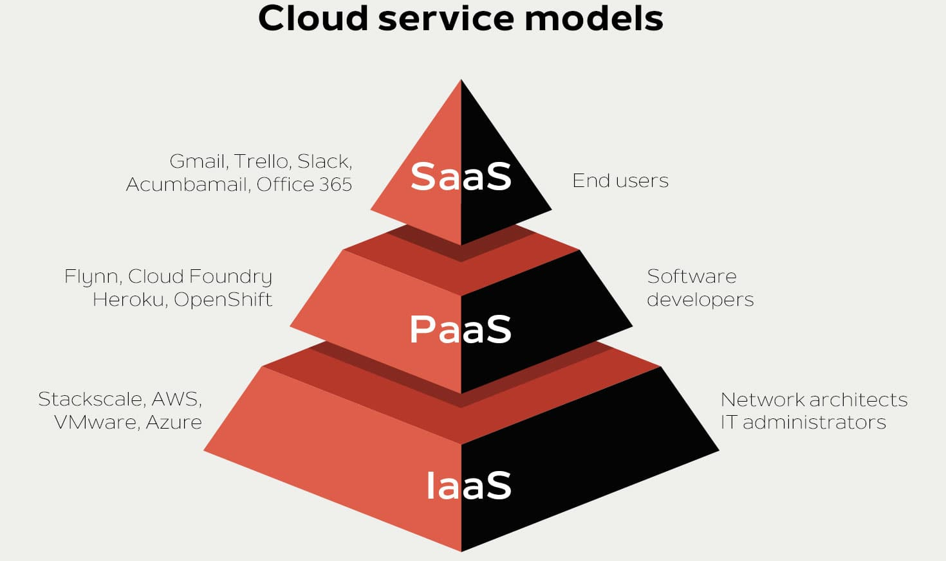
Cloud Service Models

Slide 6
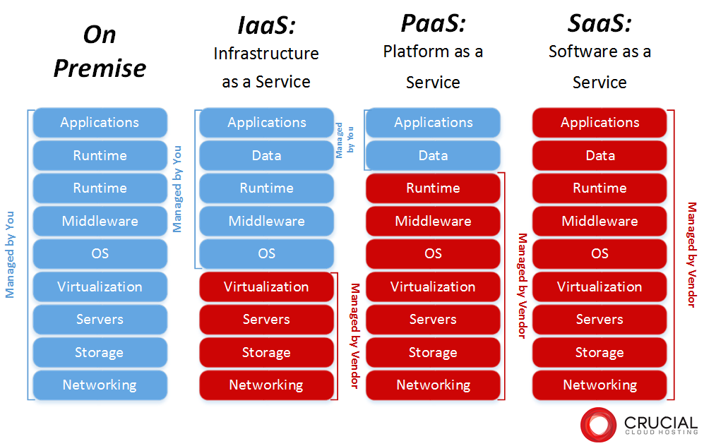

Slide 7
Software as a Service (SaaS)
Definition: Software as a Service (SaaS), on-demand software, is a software delivery model in which software and its associated data are hosted centrally and accessed using a thin client, usually a web browser over the internet.
Simply put, SaaS is a method for delivering software that provides remote access to the software as a web-based service. The software service can be purchased with a monthly fee and paid as you go.
Typically, these services are available to the customer for a fee, pay-as-you-go, or a no charge model.

Slide 8
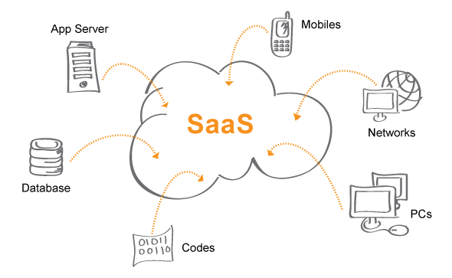
Software as a Service (SaaS)
SaaS is a model of software deployment where an application is hosted as a service provided to customers across the Internet.
The customer accesses the applications over the internet.
SaaS alleviates the burden of software maintenance/support
but users relinquish control over software versions and requirements.

Slide 9
Applicability of SAAS
Enterprise Software application:
Sharing of data between internal and external users e.g. : Salesforce CRM application
Single user Software application
Runs on single user computer and serves 1 user at a time e.g. : Microsoft office
Business Utility SaaS - Applications like Salesforce automation are used by businesses and individuals for managing and collecting data, streamlining collaborative processes and providing actionable analysis. Popular use cases are Customer Relationship Management (CRM), Human Resources and Accounting.
Social Networking SaaS - Applications like Facebook are used by individuals for networking and sharing information, photos, videos, etc.

Slide 10
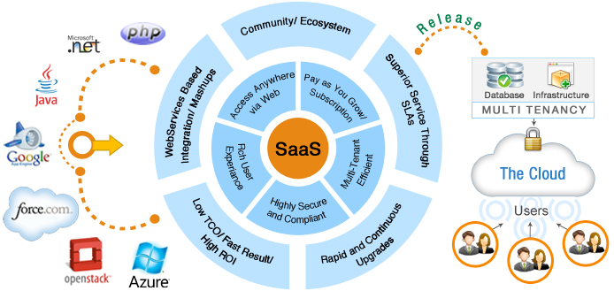
Consideration for SAAS Application development

Slide 11
Important factors for good design of SAAS model
Three distinct points that separates a well-design from a poorly designed SAAS application
scalability
Multi tenant efficient
configurable
Scalability- maximizing concurrency, and efficient use of resources
i.e. optimizing locking duration, statelessness, sharing pooled resources such as threads and network connections, caching reference data, and partitioning large databases

Slide 12
Important factors for good design of SAAS model
Multi-tenancy – important architectural shift from designing isolated, single-tenant applications
One application instance should accommodate users from multiple other companies at the same time while providing transparency
This requires an architecture that maximizes the sharing of resources efficiently across tenants

Slide 13
Important factors for good design of SAAS model
Configurable - a single application instance on a single server has to accommodate users from several different companies
Customizing the application for one customer will change the application for other customers as well.
Traditionally customizing an application would mean changes in the code.
Each customer must use metadata to configure the way the application appears and behaves for its users.
Customers configuring applications must be simple and easy without any extra development or operation costs

Slide 14
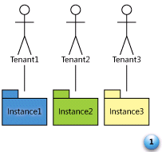
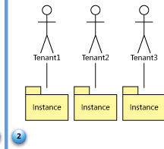
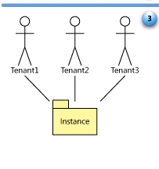
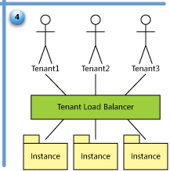
SaaS Maturity Model
Level 1: Ad-Hoc/Custom – One Instance per customer
Level 2: Configurable per customer
Level 3: configurable & Multi-Tenant-Efficient
Level 4: Scalable, Configurable & Multi-Tenant-Efficient
Source: Frederick Chong and Gianpaolo Carraro, “Architectures Strategies for Catching the Long Tail”

Slide 15
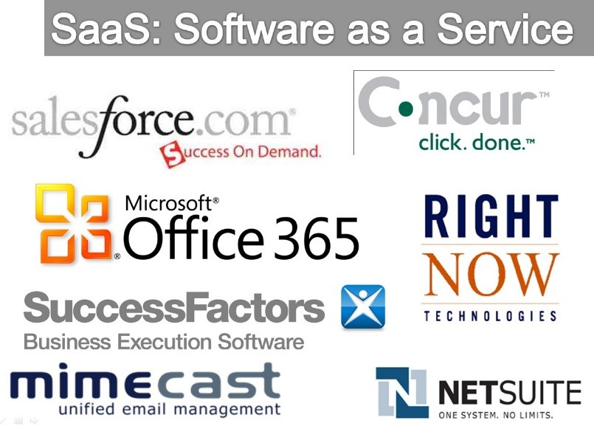
SAAS service providers

Slide 16
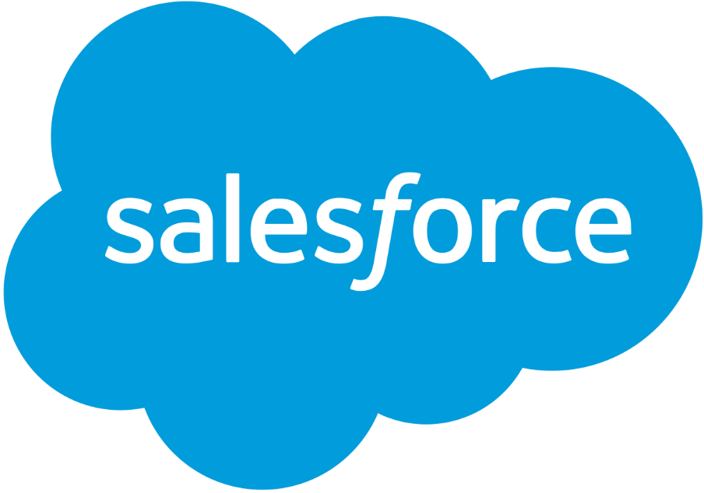
Salesforce.com
Salesforce CRM provides a complete solution for that includes feature-rich solutions for marketing, sales, services, partner management and community management.
CRM is originally software for managing customer interaction, such as scheduling tasks, emailing, texting, and many more.
Salesforce grew into a cloud software solution and acquired several other companies for Paas(Platform as a Service) and Saas (Software as a Service).

Slide 17
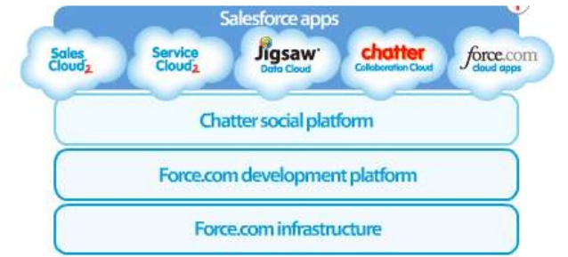
Salesforce services

Slide 18
Advantages of SaaS
Easy to use – Most SaaS applications do not require more than a web browser to run
Cheap- The pay as you go pricing model of SaaS makes it affordable to small businesses and individuals.
Scalability: SaaS application can be easily scaled up or down to meet consumer demand. Consumers do not need to worry about additional computing infrastructure to scale up.
Applications are less prone to data loss since data is being stored in the cloud.
Compared to traditional applications, SaaS applications are less clunky. They do not require users to install/uninstall binary code on their machines.
Due to the delivery nature of Sass through the internet, SaaS applications are able to run on a wide variety of devices.
Allows for better collaboration between teams since the data is stored in a central location.
Velocity of change in SaaS applications is much faster.
SaaS favors a Agile development life cycle. • Software changes and frequent and on-demand. Most Saas services are updated about every 2 weeks and users are most time unaware of these changes.

Slide 19
Disadvantages of SaaS
Robustness:
SaaS software may not be as robust (functionality wise) as traditional software applications due to. browser limitations. Consider Google Doc & Microsoft Office.
Privacy :
Having all of a user’s data sit in the cloud raises security & privacy concerns. SaaS providers are usually the target of hack exploits e.g. Google servers have been the target of exploits purportedly from China in the last several years
Security :
Attack detection, malicious code detection
Reliability:
In the rare event of a SaaS provider going down, a wide range of dependent clients could be affected. For example, when Amazon EC2 service went down in April 2011, it took down Four Square, Reddit, Quora and other well known applications that run on it.
We shall discuss each of these issues in more details in the next chapter

Slide 20
Summary
SaaS greatly enhances the ability of developers to scale their application on demand and better suite customer needs.
It encourages Agile practices by enabling providers deliver frequent updates/patches without waiting for major release cycles as in traditional applications.
SaaS applications however are susceptible to privacy, security and reliability concerns.
Hybrid environments combining both SaaS and traditional application methodologies may be useful in scenarios of extremely sensitive data or where constant up-time must be maintained.

Slide 21
PART 2
Platform as a Service (PaaS)

Slide 22
What is a Platform?
A platform is anything you can leverage to accomplish something in a simpler, faster, or otherwise better way than you could without.
As a programmer, you leverage pre-existing code rather than starting from scratch and writing everything.
The most well-known software platforms for desktop software are Windows and Mac OS

Slide 23
Web Platforms
the infrastructure or hosting layer is analogous to desktop computer hardware and the platform layer is analogous to a desktop operating system.
Additional features such as email distribution lists, contact form handlers, e-commerce options and other tools that make it easier to build and run a website are part of almost every hosting service,

Slide 24
Goals of PaaS
The ultimate goal of a PaaS is to make it easier for you to run your website or web application no matter how much traffic it gets.
You just deploy your application and the service figures out what to do with it.
A platform as a service should handle scaling seamlessly for you so you can just focus on your website and the code running it.

Slide 25
Why PaaS?
There is always a conflict between the developers and the System Engineers
Developers are keen on getting their environments up without waiting.
System Engineers care about performance and stability
Creates a peaceful environment for both parties

Slide 26
PaaS
Public solution stacks for web applications
OS, web server, language interpreters, provisions for automatic scaling, all shielded from the user
Each system only has a few supported languages
Automatic deployment and scaling not trivial
Offers development tools
Libraries for specific services
IDE plugins, deployment tools
Two types – Instance PaaS, Framework PaaS

Slide 27
PaaS properties
Gives the programmer a solution stack
Web server, database engine, scripting language
Simple deployment, no worries about servers, storage, network, scaling, updates, …
Guarantees multitenancy for better security
Users isolated by virtualization or OS means
Accounting and billing of used resources
Different at every vendor
Development tools

Slide 28
PaaS types
Instance PaaS
Depends on IaaS layer for multitenancy
Better security and performance guarantees
Deploys applications to IaaS instances
Framework PaaS
Uses OS capabilities for multitenancy
Better resource utilization and accounting granularity
Requires specific frameworks to be used
Can benefit from cloud infrastructure, but is not dependent on it
Metadata PaaS
Client configures his service through metadata

Slide 29
Available systems
Instance PaaS
Amazon Elastic Beanstalk
Microsoft Azure
Framework PaaS
Google App Engine
VMware Cloud Foundry

Slide 30
Google App Engine
Since Apr. 2008, commercial in Sep. 2011
Languages (in order) – Python, Java, Go
Typical Framework PaaS
Multitenancy by limiting system library functions
No filesystem writes and network sockets
Must use specific database and network services
High vendor lock-in potential (ex. emulation projects)
Quotas needed to support massive multitenancy
Daily quotas – billing, fair use
Per minute quotas – spike prevention

Slide 31
Comparison with IaaS
IaaS better for migrating existing applications
More flexible, you install your environment
PaaS has lower demands on administration
PaaS will take care of scaling if applications use correct frameworks, also redundancy and CDN
-> PaaS better for new applications
BUT has dangers of vendor lock in if platform specific functions are used
IaaS instance can be copied to your server.

Slide 32
Comparison with Webhosting
Webhosting essentially does the same – offers a platform for web sites / applications
Minus scalability, multitenancy, accounting
Plus personal contact – negotiation, support
Different languages, cloud focuses on scalability
Hosting: PHP, ASP, some Perl and Python
Cloud: Java, Ruby, PHP (due to demand), Node.js
Added value – e-mail and domain hosting
vs. development tools and web services in PaaS

Slide 33
GAE – Services
Data storage based on Google File System
Over it BigTable noSQL database engine
Providing Datastore and Blobstore APIs (GQL lang.)
For Java JDO and JPA compatibility layers
Problem – not SQL: no indexes, no joins –> very limited
Datastore – Master-Slave or High Replication
Google Accounts, HTTP fetch, e-mail send, XMPP, Memcache, image manip. and others
Client libraries for all APIs in Eclipse plugin

Slide 34
GAE – Limitations
No state information between HTTP requests
All sessions etc. in datastore
Good for instance unloading and scalability
Event style programming, 30 s per request
Last year: Single-threaded instances default
Can be overriden with <threadsafe> in config
Task queues (60s tasks) and backend instances
Specific programming style
Practically impossible to deploy existing apps.
Vendor lock-in

Slide 35
GAE - Quotas
Basic quota enough for development
28 h CPU time per day (granularity 15 min)
1 GB datastore, 5 GB blobstore, 1 GB network traf.
If billing enabled, minor service quotas raised
$0.08 CPU hour 600 MHz (of what?), larger inst.
$0.12 1 GB net traffic
$0.24 datastore, $0.13 blobstore, $0.1 100k writes
If exceeded
Main quotas: user gets HTTP 403
Service quotas: OverQuotaError exception

Slide 36
Amazon Elastic Beanstalk
Since beginning of 2011, still Beta
Initially only Java, extended by
PHP and Python, Ruby, .NET
Amazon – major IaaS provider -> Instance PaaS
Other PaaSs on Amazon: Heroku, AppFog, ..
Multitenancy by virtualization
Each user gets his own VM instances
Some services shared, some need more instances
Minimal limitations – can migrate to IaaS

Slide 37
Beanstalk – Pricing
Free – only a management tool for other services
Prepares images with solution stacks, w/upgrades
Deploys images on EC2 instances:
m1.small – $0.085 (1,7 GB RAM, 1 ECU)
t1.micro – $0.02 (613 MB, 10% of 2 ECU)
Uses Elastic Load Balancer:
$0.025 / 1 hour, $0.008 / 1 GB
Applications and logs are on S3:
$0.14 / 1 GB and month
Uses Elastic Autoscaler, which needs CloudWatch
$3.5 per instance and month
Data transfers outbound from cloud
$0.12 / 1 GB basic price, degressive for larger volumes

Slide 38
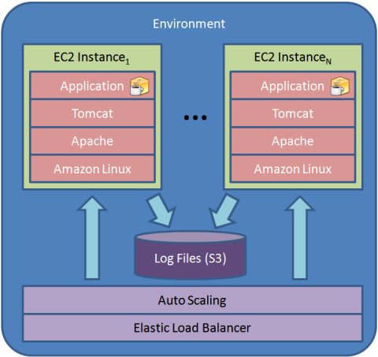

Slide 39
Beanstalk – Services
The service itself has no database, Amazon has:
Database VM instances
per hour licensing for IBM DB2 and Informix, Oracle, MS SQL, Sybase, Postgres Plus, normal instance price for free DBs
RDS – automatically managed MySQL and Oracle
does updates, backups, scaling, HA between av. zones
Paid per hour, $0.11, 2x in hot-standby, $0.1 / 1 GB
Non-relational databases with variable row format & sharding
SimpleDB - $0.25 / 1 GB, $0.14 / machine hour (shared)
Max size 10 GB, automatic indexing, website use, 1 GB & 25 h free
DynamoDB - $1 / 1 GB, $0.01 for 50 kB/s (granularity 1h)
On SSD storage, guaranteed IOPS, for data mining
Other services: MapReduce, ElastiCache, Route 53, e―mail sending, Simple Queue Service, Simple Notification Service

Slide 40
Beanstalk – Limitations
Minimal.
Applications are deployed to standard application servers (currently Apache Tomcat)
Standard relational databases available
Can disable the service and continue as IaaS only
Local storage is ephemeral, design for scalability
High price ~ $40 for minimal conf. + database
Eclipse plugin provided, API and CLI tools

Slide 41
Microsoft Azure
Since Oct. 2008, commercial in Feb. 2010
Languages: ASP.NET, PHP, Node.js, Java
Internally Instance PaaS, VM Role only recently
Web Role – runs IIS server on W2k8 and Hyper-V
Application is a web server root directory
Worker Role – no IIS
Application is a package with EXE file
For services outside IIS, ie. Java, Node.js
VM Role – runs your VHD images of W2k8
Essentially IaaS

Slide 42
Azure – Pricing
Instance PaaS – accounting by instance hours
5 instance types, prices exactly as Amazon + Win
Small: 1 CPU, 1,75 GB RAM, 230 GB disk, $0.12
ExtraSmall, 768GB RAM, 20 GB disk, $0.04
Possible to buy discount packages
Like Amazon’s Reserved Instances
Interesting SLA – 99.95% only if you have 2 inst.
Automatic updates need reboot :-P

Slide 43
Azure – Services
noSQL storage
Tables – variable row format, max. 255 attributes, manual sharding - “partition key”
Blobs – for storing large objects
Block blobs: 4 MB blocks, addressable individually or as a whole, max. size 200 GB, may use CDN
Page blobs: 512 B pages, sparse writes, snapshots
Azure Drives: page blobs containing VHD images
Queues: 8 kB XML messages for IPC
Counted together at $0.14 / 1 GB and $0.01 / 10k I/Os
SQL Azure – modified MS SQL Server with clustering
Un-cloudlike flat fees, minimum $5 for max. 100 MB
AppFabric – Access Control, SOA bus; Connect (VPN), Market (apps and datasets), Caching, MPI

Slide 44
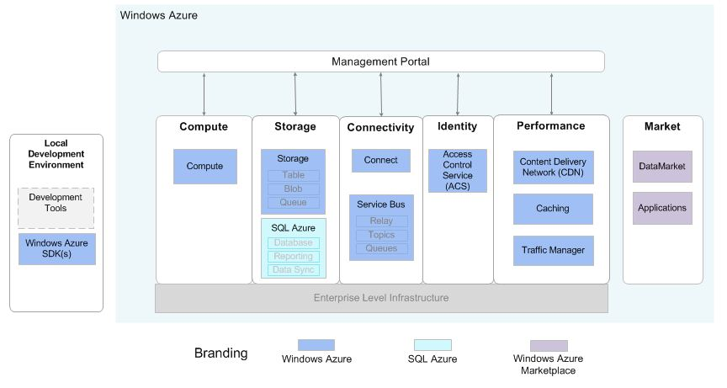

Slide 45
Azure – Limitations
MS technologies.
Windows command line, T-SQL language, Caching is not memcached, MPI is not OpenMPI
Some may view it as an advantage
A cloud classic – local storage is ephemeral
No e-mail sending service
Deployment requires writing an XML descriptor
Also needed for scaling – no built-in automation
Prices higher than Amazon – need 2 instances
Plugins for MS Visual Studio and Eclipse

Slide 46
Azure Architecture
Web role
One for each instance of software
Access control
Definition of users, groups and roles. A pre-built ASP.NET membership provider is included in the training kit.
Databases
Relational database for core operational data
Worker role
Autonomous background processing like billing
Caching
frequently used read-only, user specific, and application resource data in a high-speed distributed in-memory for faster response
Blobs
Blob storage provides a scalable, resilient way to store terabytes of user data

Slide 47
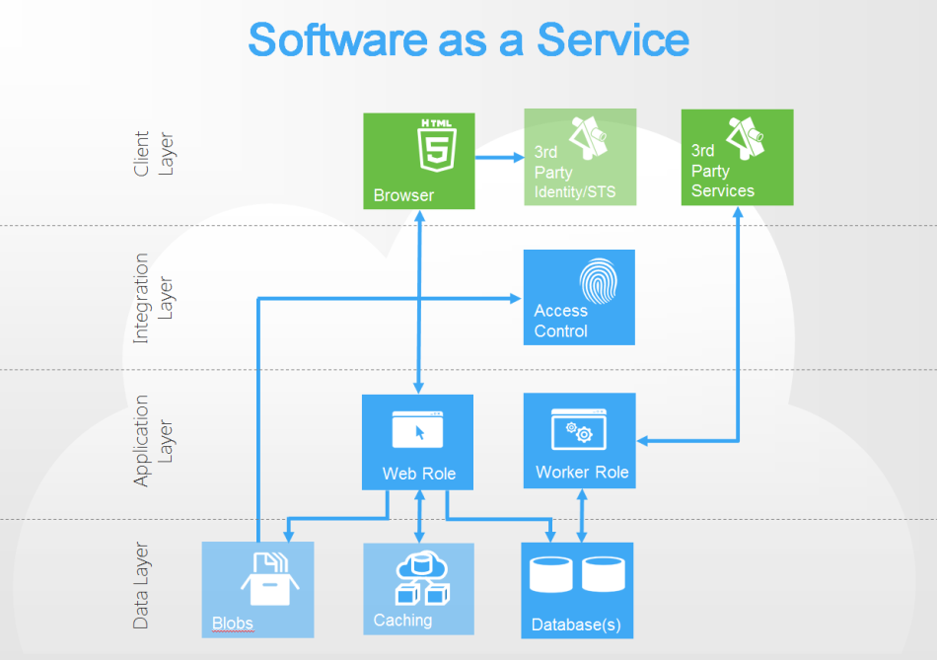
Windows Azure

Slide 48
Cloud Foundry
Since beginning of 2011, still beta
The only open source PaaS to date
Update – RedHat OpenShift now also available
There will be multiple providers, private clouds
Supports Spring for Java, Ruby on Rails (and Sinatra), node.js, Grails and Scala on Lift
Typical Framework PaaS
Unlike Google, uses standard frameworks
More added by companies and community
PHP, Django on Python, Erlang
Three versions: cloudfoundry.com, private, micro (in a VMware Player image)

Slide 49
Cloudfoundry.com
Public version is free in beta
AppFog has a commercial public cloud already
Limits:
2 GB total memory per user
Apps can have from 64 MB to 2 GB per instance
Maximum 20 applications
128 MB data in MySQL
16 MB Redis, 240 MB MongoDB
Which sums up the services, except RabbitMQ
More may be added later

Slide 50
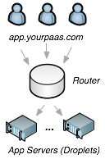
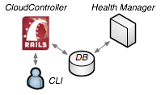
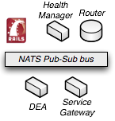
CloudFoundry – Structure
Droplet Execution Agent
Router
Cloud Controller
Health Manager
NATS message bus

Slide 51
Cloud Foundry – Limitations
Not significant if programmer adheres to framework’s design patterns
For Java – contains Tomcat application server
Low Security – only standard UNIX user/group
A local exploit will compromise the DEA, exposing other users’ apps and data
Nimbula IaaS – launches a whole CF for each user
ActiveState Stackato – a derivative using LXC
(Iron Foundry – a derivative running .NET)
Scaling is manual, local storage ephemeral
Eclipse plugin available, “vmc” CLI tool

Slide 52
The End
Dr. Mohammad Tawfik

